Slide 1
cyclistic bike share analysis
Presentation by : Nivinraj Krishnakumar
Batch: MB25

Slide 2
Ride duration and patter over time
Daily Rides Summary:
Count (Days): 30
Mean: 17,765 rides per day
Standard Deviation: 5,099 rides per day
Minimum: 6,835 rides in a day
25th Percentile: 14,428.5 rides in a day
Median (50th Percentile): 18,088 rides in a day
75th Percentile: 21,069 rides in a day
Maximum: 28,719 rides in a day
On average, there are around 17,765 rides per day.
There is significant variability in the number of daily rides, as indicated by the standard deviation.

Slide 3
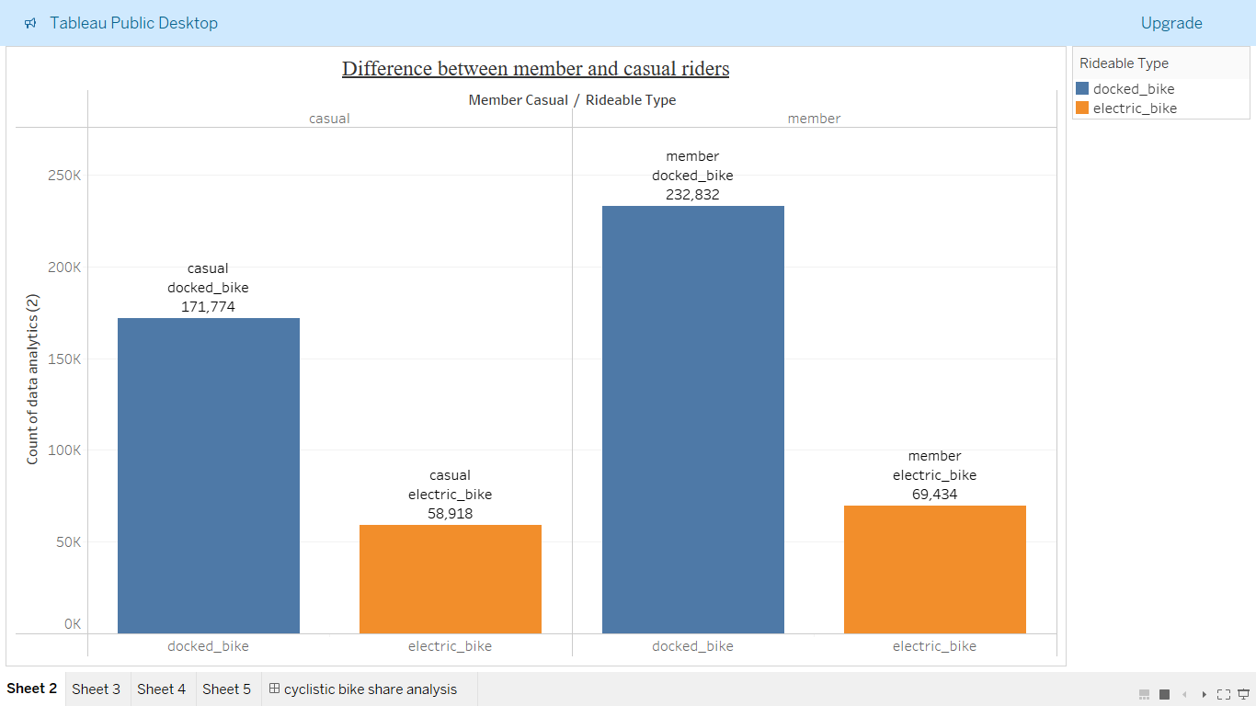
Differences between casual and member rider
# casual riders using docked_bikes = 1,71,774
# casual riders using electric bikes = 58,918
# Member riders using docked bikes = 2,32,832
# Members riders using electric bikes = 69,434
This shows that both member and casual riders uses the more docked bikes comparative to electric bikes;

Slide 4
Over all review of this analysis:
The company’s future success depends on maximizing the number of annual membership.
To maximize the number of annual membership of the riders the company needs to increase the sales of docked bikes to the riders and maximum number of membership riders uses docked bikes for their ride (i.e Member riders using docked bikes = 2,32,832) and
The company should explain the effects of docked bikes comparative to electric bike as a marketing strategy to convert the casual riders into membership riders as lots of casual riders users docked bike for their ride (i.e casual riders using docked_bikes = 1,71,774).
The company needs to concentrate on increasing the rides in minimum raided areas in order to increases the number of members.

